Slide 1
Digital Portfolio
STUDENT NAME: G.Deepak
REGISTER NO : 222404320
NM ID:AD2421862DBA1F3944E4C06D455B62C2
DEPARTMENT: BSC COMPUTER SCIENCE
COLLEGE: COLLEGE/ UNIVERSITY AGURCHAND MANMULL JAIN COLLEGE/MADRAS UNIVERSITY

Slide 2
PROJECT TITLE
Project Title: Personal Information Webpage using HTMLStudent Name, Reg No, Dept, College details

Slide 3


AGENDA
Problem Statement
Project Overview
End Users
Tools and Technologies
Portfolio design and Layout
Features and Functionality
Results and Screenshots
Conclusion
Github Link
3/21/2024 Annual Review

Slide 4

PROBLEM STATEMENT
“To design a simple HTML webpage that displays personal information in a structured format using only basic HTML tags.”

Slide 5

PROJECT OVERVIEW
“This project is a digital portfolio webpage. It contains sections such as About Me, Education, Skills, and Contact Info. The aim is to demonstrate HTML fundamentals.”

Slide 6

WHO ARE THE END USERS?
StudentsTeachers / FacultyRecruiters / Companies

Slide 7

TOOLS AND TECHNIQUES
HTML5Text Editor (Notepad / VS Code)Web Browser (Chrome / Edge)

Slide 8
POTFOLIO DESIGN AND LAYOUT
Header – Name & PhotoAbout Me – Short bioEducation – Details in table formatContact Info – Email / PhoneFooter – Thank you note
8

Slide 9
FEATURES AND FUNCTIONALITY
Basic HTML tags: <html>, <head>, <body>, <h1>, <p>, <img>, <table>, <a>Displays personal info in sectionsClickable email/phone linkEasy to view in any browser

Slide 10
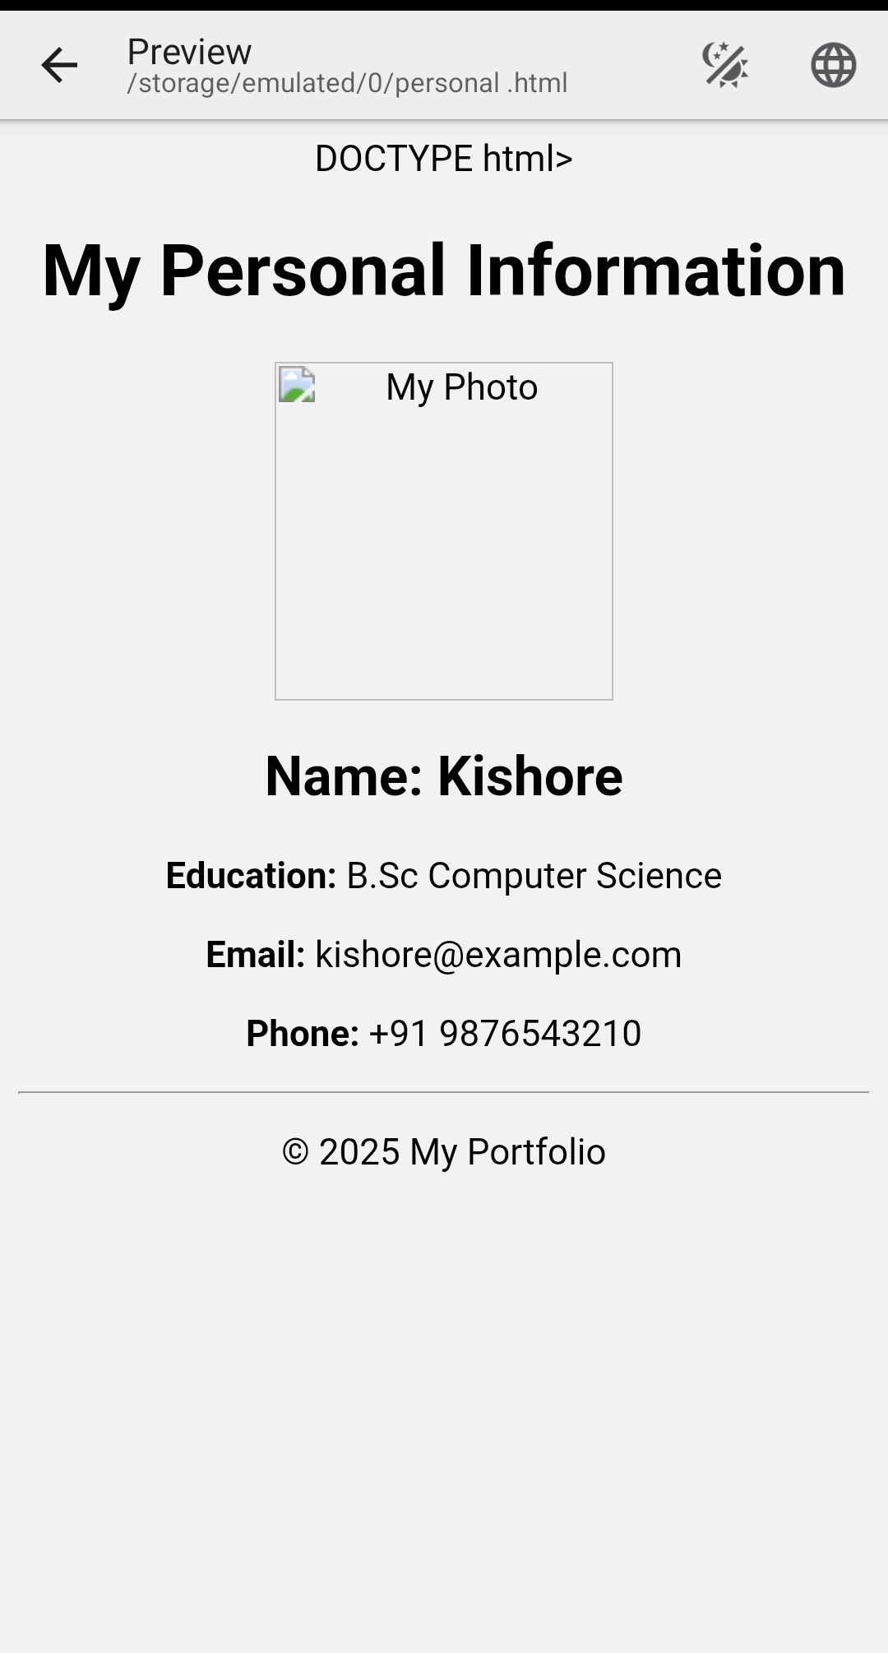

RESULTS AND SCREENSHOTS
3/21/2024 Annual Review
10

Slide 11
CONCLUSION
“This project helped me understand the basics of HTML and how webpages are structured. It improved my skills in creating digital portfolios.”
11

